Slide 1

Cybersecurity &
Risk Services
Case Study - HiTech

Slide 2
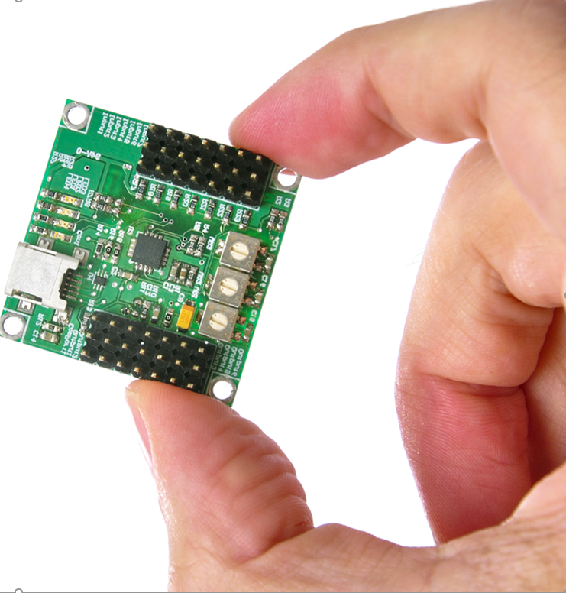
Success Story: SOC Transformation for US based Global Hi Tech Company
SOC Transformation for American Hi Tech Company to AI MDR based Cyber Fusion
SOC Transformation Story
Challenges
Solutions
Non-Scalable ”platform and commercial model”
Legacy SOC “without AI/ML capabilities”
Existing MSS Partner “without any platform visibility”
Limited capabilities for advanced insider threats
SOC Platform Infrastructure and admin overhead
Wipro AI MDR solution with best security analytics and automation playbooks
  Industry leading SOC Use Cases & ML Setup, leveraging Market Leading platform “Securonix”
  Security Operations automation using Wipro’s Playbook library, leveraging industry leading platform “Cortex XSOAR”
  Threat Hunting using Wipro threat hunting queries
  3 Year SOC Roadmap with automation journey
Deliver as a managed services, driving outcome, by owning platform and services
Wipro MSSP services
  24x7 Security Monitoring & Analysis
  Next Gen SOC with global coverage
  Automation as a Service
  Security Incident Response
  Threat Hunting
  Platform Management & Engineering
  Continuous Improvement
Value Delivered
Upto 50% efficiency in mean time to detect and response (MTTD & MTTR)
No Capital expense, with highly scalable solution
outcome based pricing model, accommodating increasing transaction volume trend
Enhanced security posture visibility on single glass of pane for all levels (CXOs, Mgrs, Engineers)

Slide 3
Thank you

