Slide 1


Cybersecurity
and Risk Services
Enabling your transformation into a
cyber-resilient business

Slide 2
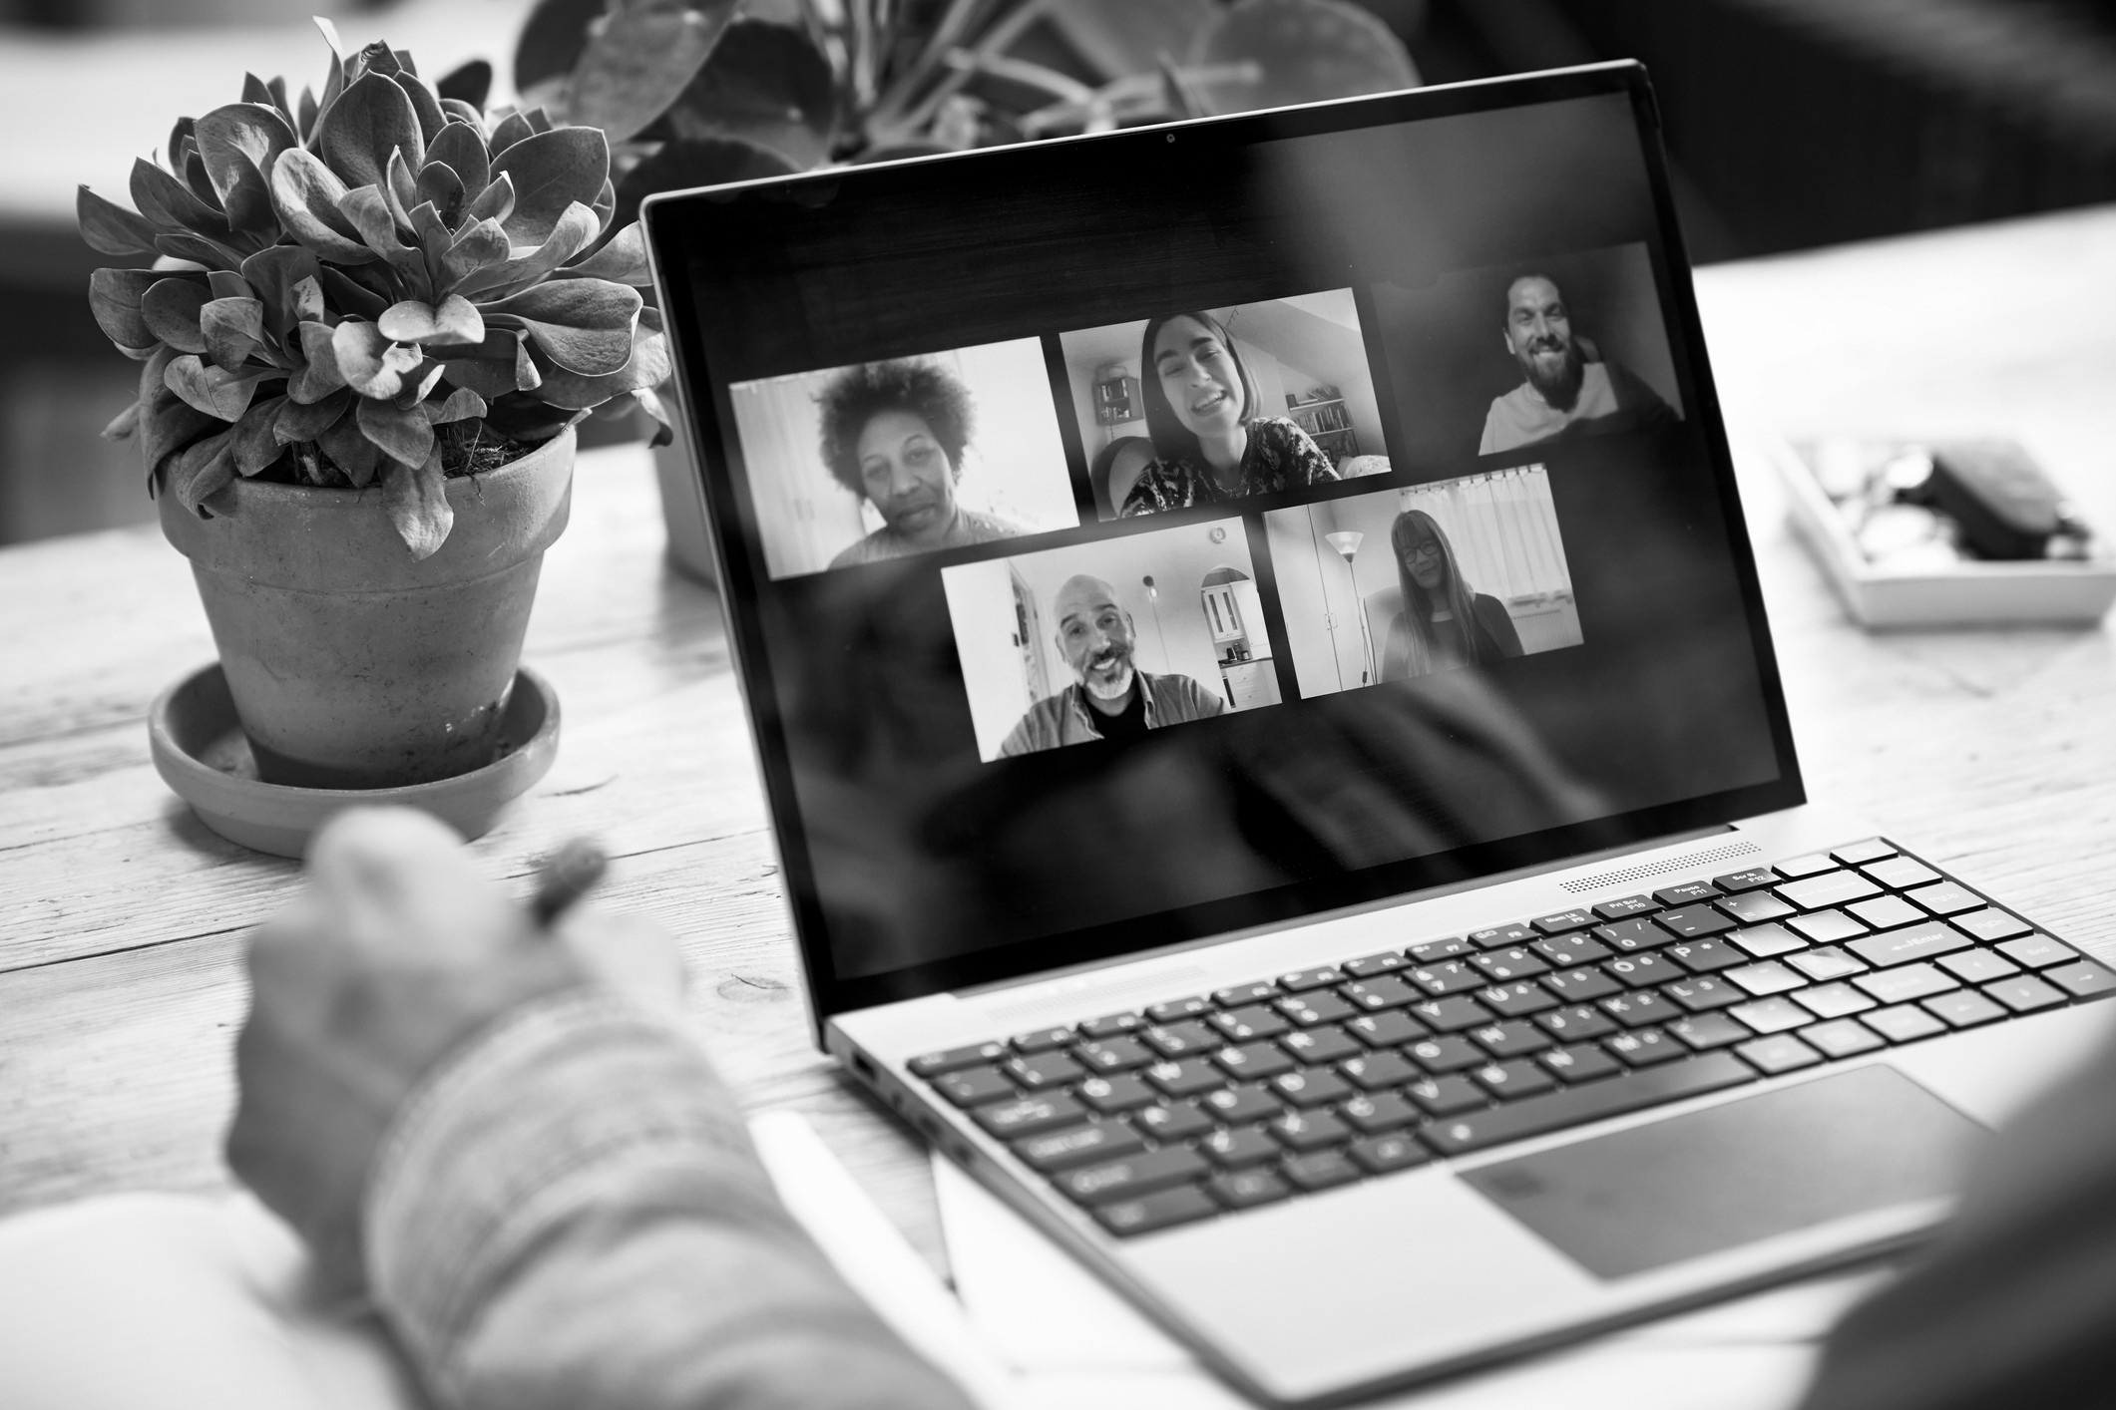

Hybrid working
has redefined the
cybersecurity landscape
An increased reliance on remote working has amplified cybersecurity needs
Conventional measures are no longer enough to ensure cyber resilience
Investment in cybersecurity initiatives can build customer trust and increase revenue
60% of knowledge workers are remote, and at least 18% of users will not return to the office.
Source: 7 Top Trends in Cybersecurity for 2022, Gartner

Slide 3




Organizations are transforming at speed
Greater investment in cybersecurity can be a market differentiator for growing businesses.
Business growth and
cost minimization
Faster and more
agile development
Evolving cybersecurity
landscape

Slide 4


Cybersecurity is adapting to emerging technologies
New technologies provide greater opportunities for organizations
A security architecture and environment must extend beyond technology into the organization’s data and processes
Organizations require executive support
to minimize risk and derive value from
their investments
The average cost of a data breach amounted to $4.35 million in 2022, which is a 12.7% increase from $3.86 million in 2020.
Source: Cost of a data breach report 2022, IBM

Slide 5

Cloud adoption
is accelerating
The cloud is a key enabler for business growth
Storing sensitive data across cloud environments increases the threat of privacy breaches and data loss
Greater cloud usage results in an expanded attack surface
Cloud adoption reduces cost through technology integration, purchases and deployment
By 2023, eight out of 10 leading firms will have advanced or fully optimized cloud environments in place.
Source: Making Business Thrive: A Cloud Leader Roadmap for Achieving 10x ROI, Wipro

Slide 6
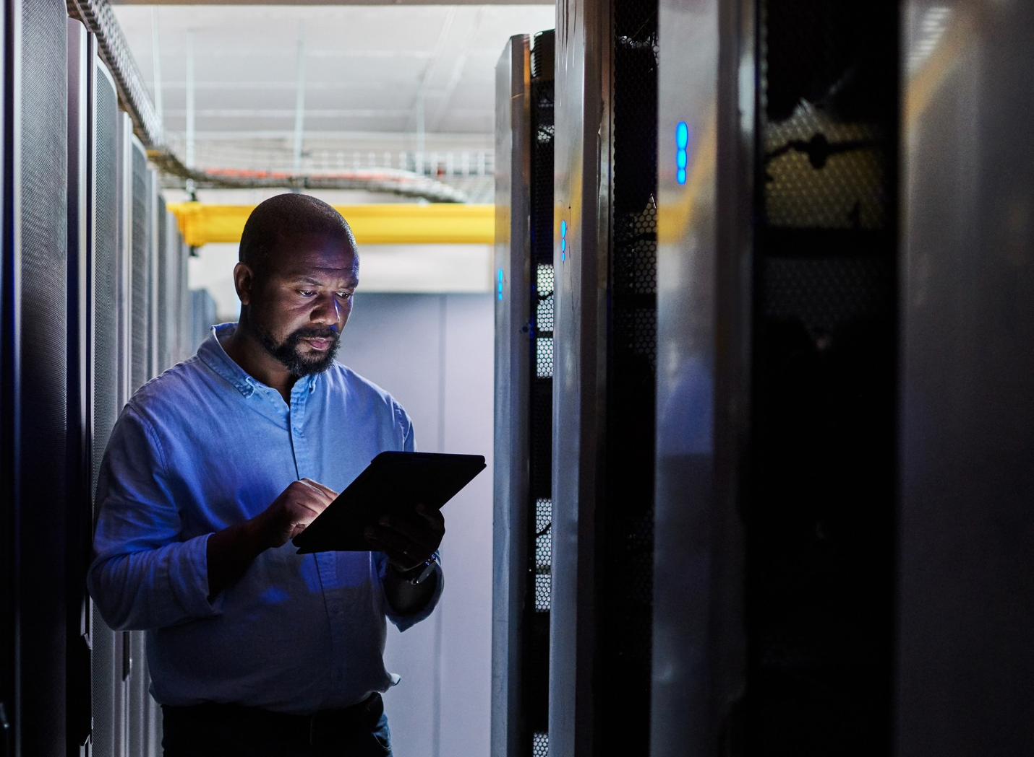



The regulatory and compliance environment is evolving faster than ever
Businesses are accelerating growth into new geographical
markets which increases regulatory complexity
ESG reporting is an increasingly important part of the
compliance landscape
In 2022, the SEC proposed new rules on cybersecurity risk management, strategy, governance and incident disclosure by public companies.
Source: US Securities and Exchange Commission, SEC
Operational burdens are growing with rising standards
and reduced disclosure periods

Slide 7




Obstacles stand in the way of a cybersecure future
Legacy systems
Increasing complexity in the cyber landscape, cloud adoption and speed
of innovation require more regular
system upgrades and business process reengineering. Organizations find it difficult to develop the right cyber capabilities in a cost-effective way that enables value.
Security expertise
A lack of skilled security experts
and a need for 24/7 support makes
attracting and retaining the best
talent difficult.
Value articulation
The benefits of cybersecurity initiatives are not clearly communicated to the board and organizations often struggle
to showcase the value and affordability of their investment.

Slide 8
In the business of the future, proven cyber resilience will drive
long-term growth.
Success relies on instilling a cybersecurity mindset within the entire organization and understanding where to concentrate resources to enable the business and protect against the greatest threats.

Slide 9







Capabilities of a cyber-resilient business
Digitally enabled
Building the business in cloud and leveraging automation
Data aware
Using data to draw real-time insights on threat detection
Strategy led
Always looking ahead to mitigate future risks
Transparent
Complying with regulations and sharing data and insights
A cyber-resilient organization focused on people, process, data and technology
Efficient
Concentrating resources
on the most significant risks
Adaptable
Responding to threats in an agile way

Slide 10






Benefits of a cyber-resilient business
A cyber-resilient organization will enable long-term growth and defend business operations.
Value drivers
Enter new
markets
Increase customer adoption
Enhance reputation and trust
Optimize processes
and operational capability
Reduce risk of security breach
Comply with
legal regulations

Slide 11
Why Wipro Cybersecurity
and Risk Services?
As strategic advisors, we drive long-term growth and enable your transformation into a cyber-resilient business through end-to-end cybersecurity services.
End-to-end CRS provider
with consulting capabilities
We bring an advisory lens to strategy, implementation and managed services for complex enterprises in highly regulated industries globally. We are one of the select few providers with cybersecurity offerings that map end-to-end to industry frameworks.
Automation-led and platform-driven services
Our security operations are delivered “as a service” and are tailored for industry use. Our integrated suite of transformational capabilities enables organizations to enhance governance of cybersecurity risk, and transform into secure, modern digital businesses.
Forward-looking approach
and collaborative mindset
Our investments, acquisitions and alliances with leading technology providers mean we are always prepared for the next challenge.
Our team is highly specialized with experience across all main industries.

Slide 12








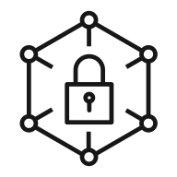
Cybersecurity services across the
end-to-end lifecycle
Advisory and
Strategy
Transformation and Implementation
Managed
Services
Strategy and
Risk
Cloud
Security
Digital
Identity
Application and
Data Security
Security Intelligence and Analytics
Regulatory and Cybersecurity Automation Platforms

Slide 13




Strategy and Risk
Enabling organizations to assess and enhance their cybersecurity risk posture.
Business needs
Business outcomes
Alignment to regulatory requirements and need for risk monitoring
Strategy and Risk
Increased brand protection and consumer trust
Cyber risk and privacy strategy
Industry security and risk advisory
Security architecture and engineering
Security governance, risk and compliance
Business continuity and cyber resilience
Cyber strategy for increasingly federated operating model
Enhanced risk visibility and improved governance
Mergers, acquisitions and heavy reliance on diverse supply chain
Compliance with tightening regulations

Slide 14


Cloud Security
Defending businesses against advanced cyber threats on-premises and on cloud.
Business needs
Business outcomes
Visibility and insights into cloud security posture, adherence to evolving compliance and regulations
Cloud Security
Quicker and secure onboarding on to cloud
Cloud security architecture
and advisory
Cloud security transformation
Managed cloud security services across AWS, Azure, Google and other CSPs, private and hybrid cloud
Detect threats and respond to protection of the data in hybrid cloud
Holistic cloud risk visibility and reduced attack surface
Unified and scalable security across hybrid cloud built on zero trust architecture
Secure business growth

Slide 15



Digital Identity
Securing digital transformation through next-gen identity and access services.
Business needs
Business outcomes
Security frameworks to safeguard
the operational environment
Digital Identity
Personalized, any time, anywhere and secure user experiences
Workforce identity and access management and governance
Consumer identity and access management
Zero trust identity
IAMaaS
Passwordless and new age solutions
Compliance with an evolving regulatory landscape
Enhanced compliance with improved productivity
Enable consumerization, digital transformation and cloud adoption
Zero Trust and Identity as-a-service adoption

Slide 16



Application and Data Security
Helping organizations to better understand and respond to application and API threats.
Business needs
Business outcomes
Secure connection via new channels
Application and Data Security
Improved security
and risk posture
Protection of mission-critical platforms
Threat and vulnerability management
Platform security
Mobile and API security
Insider threat protection
Data protection enabling business transformation
Privacy-centric data security
Managed data security services
Secure applications and organizational data
Real-time identification and mitigation of platform risks
Evolving data breach threat landscape (e.g. BYOD, cloud, IoT)
Discovery, identification and end-to-end protection for data at rest, in motion and in use
Data privacy and protection compliance

Slide 17



Security Intelligence and Analytics
Combatting against cyber threats through Managed Detection and Response (MDR) services.
Business needs
Business outcomes
Establish 24x7 Cyber Defense Centers
Security Intelligence and Analytics
Reduced risk and impact against emerging threats
MDR services using Open XDR Framework
MDR center of excellence for technology transformations
Threat advisories, hunting and simulation
Compromise and posture assessments
Tabletop exercise (IR retainer for breach response)
Malware reversing and analysis
Targeted and operationalized threat intelligence
Proactive mitigation for emerging threats (e.g. ransomware and zero-day)
Visibility to enterprise-wide threat posture
Prepare and respond to sophisticated and major incidents
Rapid response and remediation

Slide 18






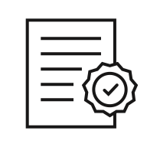


Our people combine expertise with cross-industry experience
55%
Fortune 100 companies
600+
CRS clients
across the globe
10+
Industries
25+
Years experience
9,000+
CyberSecurists
114+
Pending and
issued patents
46
Automation
platforms and accelerators
17
Cyber Defense Centers

Slide 19





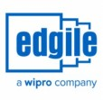









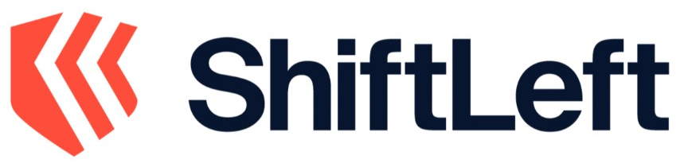















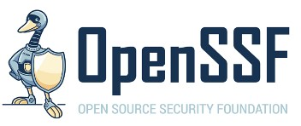





Key partnerships, ventures and acquisitions across the cybersecurity ecosystem
Hyperscalers
Cybersecurity partners
Venture partners
Acquisitions
Wipro automation platforms
Identity Management Center
Third Party Risk Management
Enterprise Data Obfuscation
Security Management Center
Cloud Applications Risk Governance
Integrated Threat Management
Cyber Defense Platform Security Intelligence
Wipro Holmes
Automated Regulatory Compliance
Recognition and community

Slide 20
Our venture investments help to build innovative enterprise security solutions
Drives real-time continuous threat monitoring across the network and the data center to instantly identify any phase of an attack.
Transforms threat detection and response for today’s hybrid cloud, data-driven enterprise, powered by the most advanced analytics.
Provides a platform that helps organizations create a standardized platform for
vulnerability management.
Offers a continuous and real-time attack surface analysis and remediation platform, enabling security teams to eliminate critical attack vectors.
Analyzes software applications from an attacker’s viewpoint to help find and fix vulnerabilities faster.

Slide 21
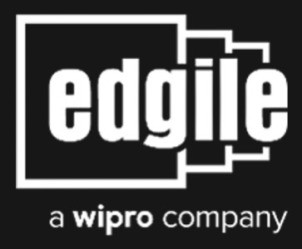


Acquisitions to strengthen our cybersecurity consulting capabilities
A cybersecurity consulting provider with security strategy capabilities
that focuses on risk and compliance, information and cloud security and digital identity.
A global management and technology consultancy providing digital, consulting and technology services to financial institutions.
A leading provider of cybersecurity, DevOps and quality engineering services in Australia, bringing scale and market agility to respond to the growing demands of customers.

Slide 22








Regulatory and cybersecurity automation platforms for actionable data and insight
Identity Management
Center
Security Management
Center
Cyber Defense Platform
Security Intelligence
Provides a single view of the Identity
and Access Management ecosystem
Identifies operational security risks across the business
Provides automated and
intelligent threat alerts
Third Party
Risk Management
Cloud Applications
Risk Governance
Wipro
Holmes
Automates the collection, validation and continuous monitoring of data
Enables visibility into risk posture and governance of applications
Accelerates growth from
cloud with AI solutions
Enterprise Data
Obfuscation
Integrated Threat
Management
Automated Regulatory
Compliance
Enhances data security through intelligently masking sensitive data
Drives real-time threat monitoring and quicker response times
Enables faster time to value through automated compliance tracking
Wipro’s cybersecurity platforms use advanced automation to increase the speed of change while reducing costs

Slide 23
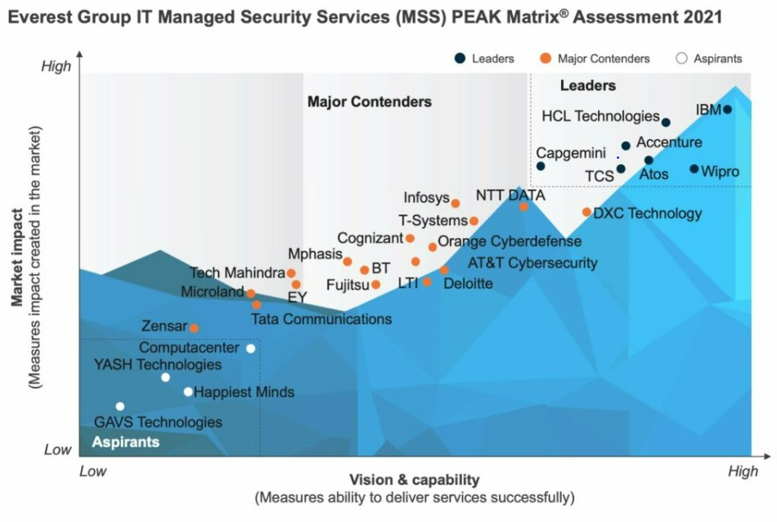
Analysts recognize
our industry leading capabilities
Wipro rated as a ‘Leader’
in Avasant Cybersecurity Services RadarView™
2022
Wipro placed in HFS
‘Winners Circle’ ​for top 10 cybersecurity service
providers 2022
Wipro recognized as a
‘Leader’ in Everest Group PEAK Matrix™ IT Managed Security Services 2021
Wipro placed as a ‘Strong performer’ in Forrester’s Global Cybersecurity Consulting Providers 2021
Wipro placed as a ‘Strong performer’ in Forrester’s European Managed Security Services Providers 2022 ​
Wipro positioned as a ‘Leader’ in the IDC MarketScape for Worldwide Managed Cloud Security Services 2022

Slide 24



Driving cost savings
for a multinational manufacturing business
The challenge
Our client had on-premises legacy systems that required ongoing maintenance and limited its ability to support digital and cloud transformation. Managing servers and ensuring up-time was costly and our client wanted to upgrade Identity and Access Management (IAM) infrastructure to combat advanced cyber threats.
Outcomes
The solution
Delivered a detailed assessment of IAM integrations, with migration impact and feasibility study
Created a unified IAM architecture blueprint to support multi-cloud transformation strategy
Adopted Agile methodology to rapidly migrate five IAM solutions to Microsoft IAM platform, featuring Microsoft Identity Manager and Azure Active Directory
99.95%
Uptime for identity services
120+ servers and 20+ directories and databases decommissioned for significant cost saving
Cloud-ready IAM architecture to support ongoing digital transformation journey
Notes:
Source: Wipro Microsoft Security_Induction_CRS.pptx – slide 15

Slide 25



Improving cloud threat
visibility for an Australian government agency
The challenge
Our client was responsible for building and maintaining road infrastructure across Australia. The agency wanted to improve the hybrid cloud environment security risk posture by elevating threat management capabilities, while facilitating engagement with customers via new digital channels.
Outcomes
The solution
Established a centralized Security Operations Center to detect and respond to security events for sensitive assets
Migrated business applications to AWS using DevOps and Secure by Design principles
Leveraged Wipro Vulnerability Management as a Service platform to provide automated, scanner-based and agent-based solutions
2,000+
Critical devices onboarded on AWS
Increased visibility and minimized impact of cloud cybersecurity breaches
Rapid app development and cloud migration at scale
Notes:
Source: https://www.wipro.com/cybersecurity/how-a-leading-government-agency-ensured-fast-and-secure-migration-to-aws-cloud/

Slide 26


Enhancing user experience for a
global conglomerate
The challenge
Our client had a historical Identity and Access Management (IAM) solution. There were concerns around the limitations in the current solution in terms of certification, identity analytics, continuous compliance, self-service, mobility and automated reporting.
Outcomes
The solution
Invested in an Identity and Access Management (IAM) strategy and roadmap definition engagement
Assisted in product evaluation and proposed SailPoint as the NextGen Identity, Governance and Administration (IGA) solution
Utilized the Identity Management Center (IMC) to accelerate onboarding of SAP applications
243
SAP applications onboarded
Enhanced user experience with self-service and mobility
Accelerated application onboarding using Wipro’s IMC standardization
Notes:
Source: Everest Group PEAK Matrix for IT Security Service Provider 2022 - page 7

Slide 27



Reducing security management costs for a global telecom company
The challenge
Our client needed to design and implement a secure Mobile Virtual Network Operator solution in less than nine months to support their entry into the US market. Concerns were raised over data confidentiality and integrity when moving to the cloud on an Amazon Web Services (AWS) environment.
Outcomes
The solution
Designed security architecture to provide protection to applications, data and infrastructure components on AWS
Produced a layered security approach to ensure the cloud environment was monitored and managed through a Cyber Defense Center
Combined AWS native and third-party controls to align with overall business requirements and cloud security policy
23%
Reduction in operating expenditure in first year of engagement
Enhanced security assurance and alignment with data privacy compliance requirements
Reduced complexity of managing workloads and security concerns on AWS Cloud
Notes:
Source: https://www.wipro.com/cybersecurity/how-a-top-telco-launched-its-business-in-the-us-market-on-cloud/

Slide 28



Modernizing identity environment for a major manufacturing business
The challenge
Our client had no strategy in place to modernize the Identity and Access Management and Directory Environment for over 200,000 employees and contractors.
Outcomes
The solution
Developed an identity security vision with a multi-year roadmap
Implemented SailPoint to automate user access reviews and the
provisioning process
Utilized PingAccess to enable single sign-on for web
applications and application programming interfaces
50%
Increase in time efficiencies
Automated compliance, user access review process and joiner and leaver process
Enhanced user experience
Notes:
Source: Edgile_Case_Study_Fortune_100Manufacturing

Slide 29
Thank you.

